Slide 1
Communities of Practice (CoP)
Generating Authentic PD Buy-In while Reducing PD Barriers
Carrie Consalvi, Associate Dean of DE and PD
Dr. Lauren Springer, Faculty PD/DE Coordinator
Notes:
Lauren

Slide 2
Discussion
What are some participation barriers to professional development?
Notes:
Spend 5 min
Lauren

Slide 3
Our Solution:
Communities of Practice
Notes:
Lauren
CoPs mitigate or eliminate many of our own institutional barriers

Slide 4
What is a CoP?
A group of people who share a common concern, a set of problems, or an interest in a topic and who come together to fulfill both individual and group goals.
Often focused on sharing best practices and creating new knowledge to advance a domain of professional practice.
Notes:
Lauren

Slide 5
Why CoPs Work?
Complex problems require more implicit knowledge, which cannot be codified.
Implicit knowledge can only be shared through conversations and observation.
New ideas come from diverse networks, often from outside the organization.
Learning is part of work, not separate from it. Communities of practice enable the integration of work and learning.
Andragogy is critical for instructors. Consider point of need, self-directed learning, and application of prior experience.
Notes:
Lauren

Slide 6
Factors of CoP Success
Ownership: Communities of practice thrive on social energy, which both derives from and creates identification.
Leadership: The dedication and skill of people who take the initiative to nurture the community.
Time: Because time is at such a premium, a key principle of community cultivation is to ensure “high value for time” for all those who invest themselves.
Wenger, McDermott and Snyder. Cultivating Communities of Practice: A Guide to Managing Knowledge. Cambridge, MA: Harvard Business School Press, 2002. Accessed November 30, 2014 at: http,//hbswk.hbs.edu/archive/2855.html
Notes:
Lauren

Slide 7
Our CoP Story
Notes:
Lauren

Slide 8
We Identified a Need
Enrollment increase
Onboarding delays
Waitlist demands
Catalyst for late start classes
Poor Success data
Notes:
Lauren

Slide 9
Steps to Creation
1
2
3
4
5
6
Determine the need, looking for gaps, needs assessments, FAQs, HelpDesk, etc.
Gather research on the topic, and make an outline.
4-6 weeks works
Short is better
Generate Discussion questions
Self reflection
General group discussion
Determine the best time of the semester for point-of-need.
Create a call-out for participants
Availability
Facilitator
Form groups of 6-8 for best discussions (and to address drop outs)
Notes:
Lauren

Slide 10
Steps to Creation
7
8
9
10
Repeat!
Assign facilitators to create the meeting schedule and run discussions.
Post to the CoP once weekly with a reflection survey, materials, and discussion questions.
Meet once the CoP is over for a final reflection meeting. Good for feedback!
Take attendance and submit for flex.
Notes:
Lauren

Slide 11
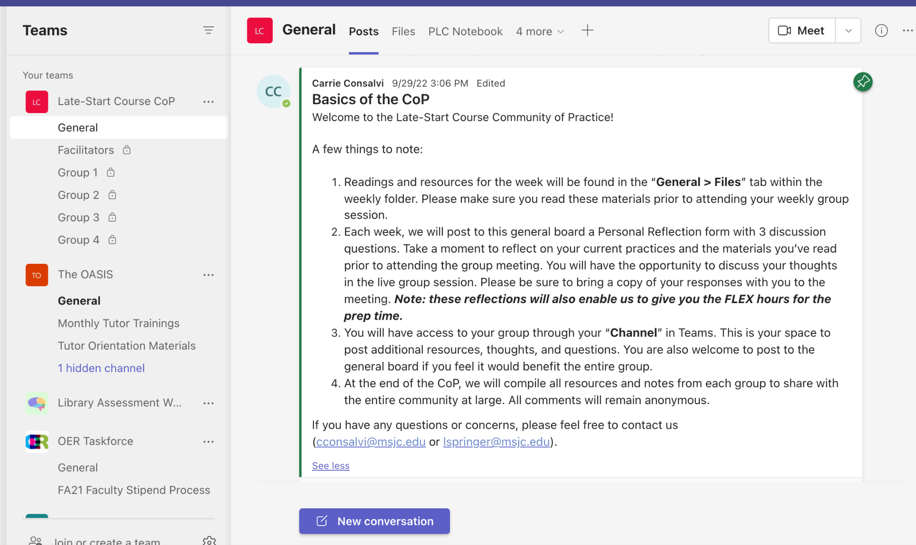
Late-Start 8-Week CoP
Notes:
Carrie

Slide 12
What are the benefits of our CoP Structure?
Increases productivity by minimizing time expenditure
Repeatability (with minor revisions)
Select specific components (participation level)
Point of need
Supports novice teachers
Informal mentoring support structure
Notes:
Carrie

Slide 13
The Feedback
55% said a sense of community or less isolation was the biggest takeaway in the CoP
“The most worthwhile of this even [sic] was the sense of community. I didn’t feel so overwhelmed in starting on a new campus, and I felt supported” - Fall 2022 CoP participant
65% left with a new strategy or activity
“I liked that I was able to get feedback from other teaching faculty and advice on how to look at things differently.” - Fall 2022 CoP participant
Notes:
Carrie

Slide 14
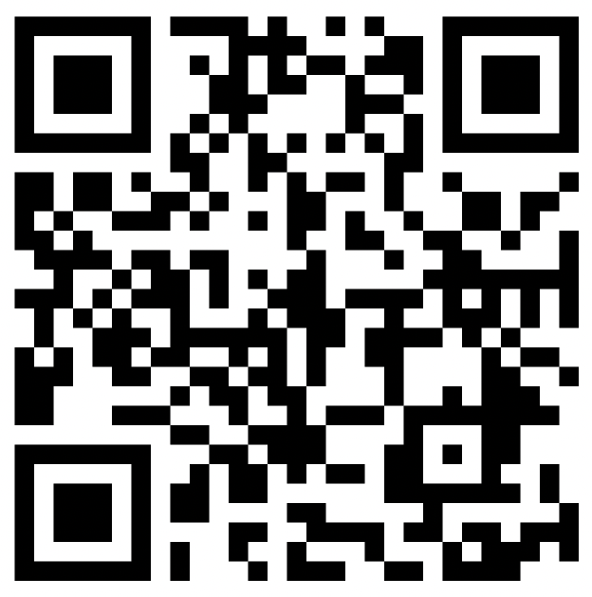
Brainstorming Session
Spend 3 minutes individually writing down potential CoP topics.
Share ideas with your table.
Vote on the topic you want to explore.
Create a 4 week outline of sub-topics you’d like to research.
Post to the Padlet.
Notes:
Be here by 3:55
Carrie

Slide 15
Things to Consider While Planning
Notes:
Lauren

Slide 16
CoP Activities
Goals or Gap Addressed: What are we working toward?
Late Start Course Success, Alternatives to Discussion Boards
Rhythm: What will be the pace and rhythm?
4 weeks + one meeting; weekly readings; weekly Zoom; Self-reflection
Communication: What’s the best platform to do this?
Microsoft Teams with specific channels
Engagement: What is valuable for the participation of the group?
Self-directed/parceled approach
Attendance at meetings & self-reflection each at 1 hr.
Sample Plan for One-year Community of Practice
Notes:
Lauren

Slide 17
Participation Credit
Flex Participation
1 hr for readings/reflections
1 hr for Zoom discussion
Parceled Approach
Could elect to participate however they want
Attendance taken at each meeting
Facilitator receives extra Flex time for managing the CoP
Entered into Cornerstone after session is complete
Notes:
Lauren

Slide 18
Facilitators
Identify a Facilitator and Roles
The facilitator’s role involves consulting, connecting, facilitating, helping, and guiding. Facilitators cultivate and sustain the community through:
Monitoring activities
Encouraging participation
Reporting community of practice activity (through metrics and evaluations)
Collecting and sharing evidence of participation and impact
Managing community of practice events (including face-to-face meetings and live webinars).
Facilitators
Notes:
Lauren

Slide 19
Types of Research
Consider how content fits into one or more of the following three categories:
Materials and information that participants can read and review on their own
Knowledge and information that benefits from listening to a structured presentation or a subject matter expert
Shared knowledge and experiential learning that benefits from interaction between participants.
Notes:
Lauren

Slide 20
Designing for Online Participation
Create opportunities for open dialogue.
Welcome and allow different levels of participation.
Combine familiarity and excitement.
Consider how the collaboration tools that are part of conferencing software can be used to do this— voting, short answer polls and white boards are all strategies for participants to share and document their ideas.
Find and nurture a regular rhythm for the community.
Notes:
Lauren

Slide 21
Types of Data to Collect
Throughout the life cycle of the community, three basic kinds of data can be collected:
Needs assessment: What do members of the community want and need?
Participation: How active was the community?
Impact: How did practice change as a result of the community of practice?
Sample Data Gathering Plan
Sample Reflection Form and Final Assessment from Late Start CoP
Notes:
Lauren

Slide 22
Make a Legacy Plan
How will you share your materials?
Will there be other deliverables?
How will you share with your colleagues?
How will you know it’s successful?
Will the CoP meet for 30, 60, 90 days after?
Notes:
Lauren

Slide 23
Barriers to Engagement
Notes:
Carrie

Slide 24
Engagement
Timing: Difficulty scheduling the sessions
Our faculty did not want to create their own content.
Modality: Is f2f or online more manageable?
Interest: Is the topic at the point of need and interesting?
Marketing: Do people know about it and did we use the right language?
Notes:
Carrie

Slide 25
Discussion Questions
How do we foster high levels of engagement from classified, faculty, and admin in the Communities of Practice?
Notes:
Carrie

Slide 26
Equity
On-trend Key Terms: Do some people disengage when they see the words?
Saturation: Have we reached the point of crossing the chasm of change?
Perceptions: Do they see themselves represented in the facilitation?
Marketing: Are we promoting the right things for the engagement we want?
Notes:
Carrie

Slide 27
Discussion Questions
How can we address potential resistance or pushback to equity topics in the way we market our professional development?
Notes:
Carrie

Slide 28
Technology
Digital Literacy: Do they know how to use the platform?
Modality: Is it the right tool for the kind of engagement we want?
Support: Do we have adequate support for those who need scaffolded instruction?
Notes:
Carrie

Slide 29
Discussion Questions
Given that some participants may feel intimidated or lack the skills to use basic technology, how can we approach this challenge within our professional development framework?
Notes:
Carrie

Slide 30
Expansion of CoPs
Notes:
Carrie

Slide 31
Expansion of CoPs
Create a template for CoP building
Encourage post-CoP continuation
Create an assessment loop post-participation
Facilitate user-generated CoPs
Create out-of-the-box packages for interested participants
Notes:
Carrie

Slide 32
Are there any questions?
Notes:
Carrie

Slide 33
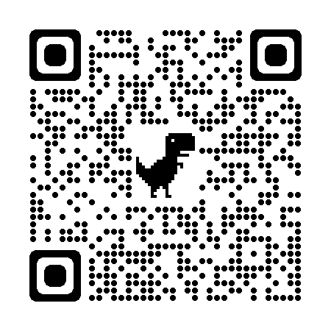
Reach us:
Carrie Consalvi, cconsalvi@msjc.edu
Lauren Springer, lspringer@msjc.edu
Scan the QR Code for our 8-Week CoP materials.

